Slide 1


Slide 2

Schedule
What are microcontrollers ?
INTRODUCTION TO MICROCONTROLLERS
Main uses, detailing, which to use…
Differences between some microcontrollers
BONUS
LIGHTING IoT PROJECT
USING PHOTOVOLTAIC ENERGY
Differences between Arduino UNO, ESP32 and Raspberry PI
ARDUINO
Creation;
Arduino Uno detailing
Multimeter, wire gauge and project.
Show multimeter usage;
How to calculate the Wiring Gauge to be used;
Battery association + Project.
2022 Lenovo Internal. All rights reserved.

Slide 3

WHAT ARE MICROCONTROLLERS?
A microcontroller is a single integrated circuit chip that contains a processor core, memory, and programmable input and output peripherals.

Slide 4
MAIN USES
Automation of various systems;
Brightness control;
Timers;
Sensor reading;
The usability is huge!

Slide 5
WHAT TO CHECK BEFORE LEAVING USING A MICROCONTROLLER?
Datasheet;
Web forums;
Developer channels;
Web Search;

Slide 6
WHICH MICROCONTROLLER TO USE IN THE PROJECT ?
Computing power
Voltage and amperage
Versatility
Final cost
Between others...

Slide 7
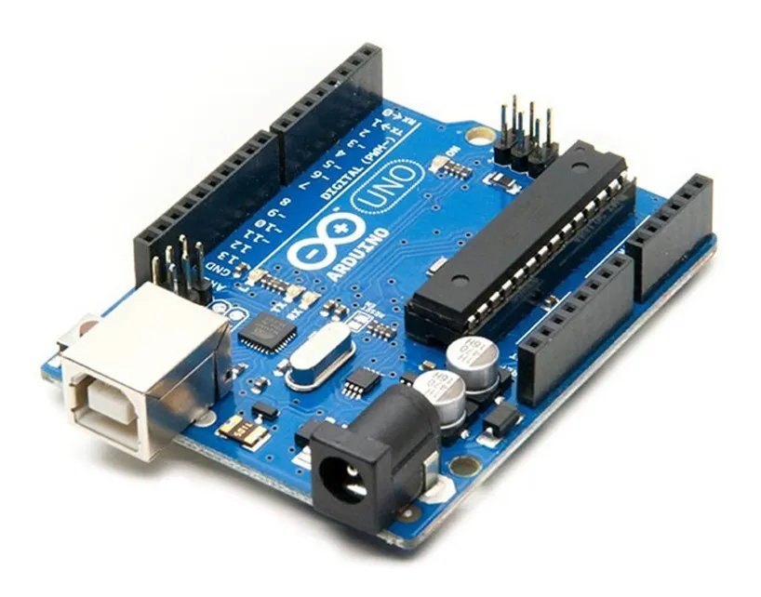

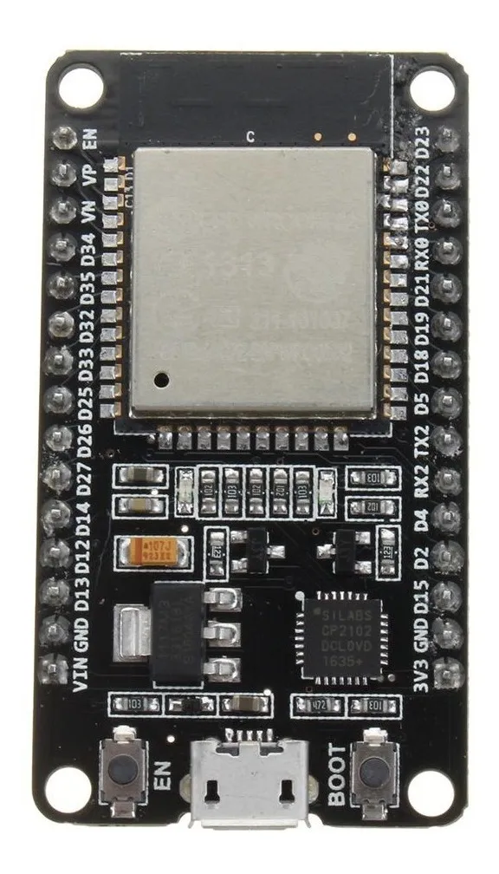
MAIN DIFFERENCES BETWEEN ARDUINO, RASPBERRY PI AND ESP32
Computing power
Voltage and amperage
Versatility
Final cost
Arduino UNO
2005
R$112,00
Raspberry PI 3
2012 - 2016
R$1249,00
ESP 32 2016
R$75,90

Slide 8
SUMMARY OF THE DIFFERENCES BETWEEN ARDUINO, RASPBERRY PI AND ESP32
 | ARDUINO UNO | ESP32 | RASPBERRY PI 3
A | 40mA | 220mA | 1200mA
Clock | 8 bits | 32 bits | 1.2 GHz 64 bits
Bluetooth | NO | 4.0 | 4.1
Wi-Fi | NO | YES | YES
RAM | 2Kb | 520Kb | 1Gb

Slide 9

ARDUINO MICROCONTROLLER OVERVIEW
Creation;
Board configuration;
IDE download and installation
See this microcontroller in more detail

Slide 10
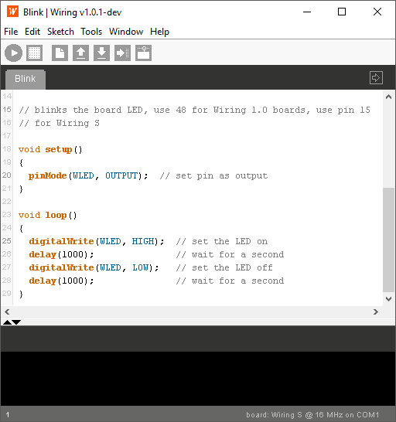
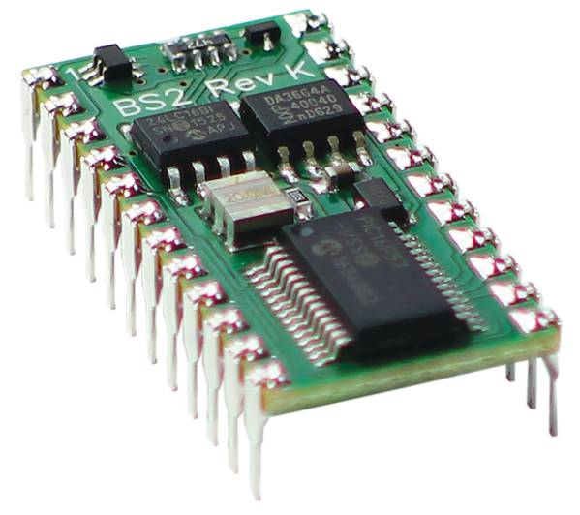
ARDUINO CREATION
Basic stamp
Wiring-Blink

Slide 11
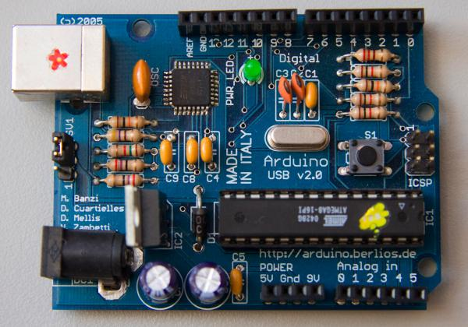
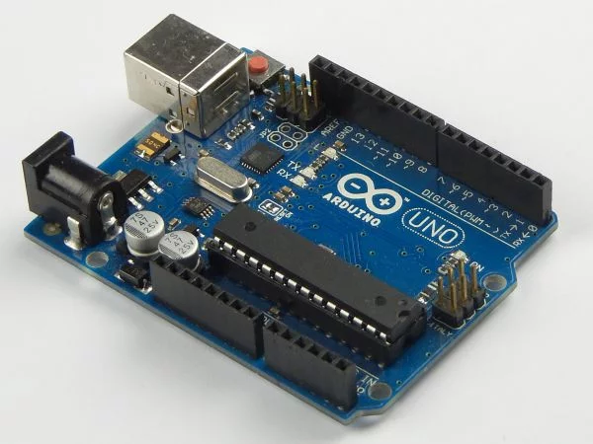
ARDUINO CREATION
Arduino-USB-v2
Arduino UNO

Slide 12
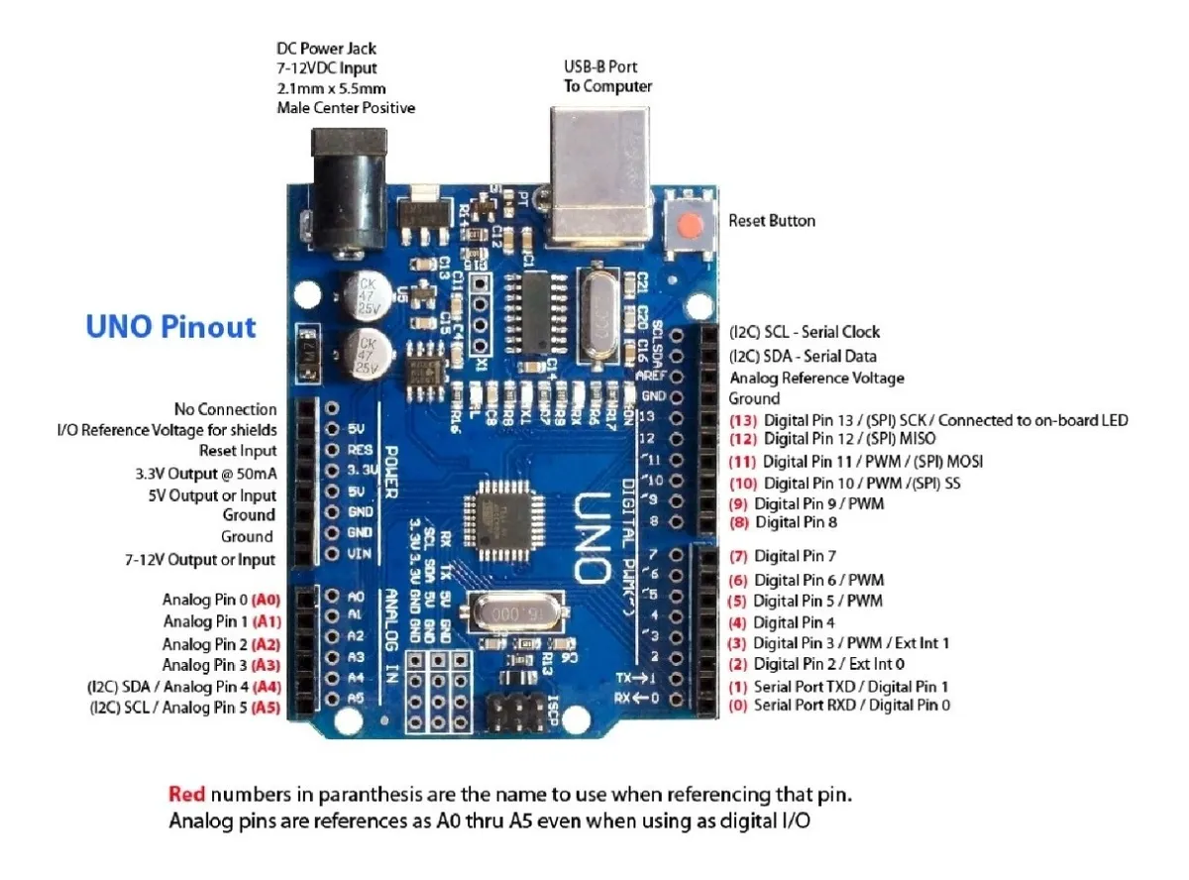
MORE ABOUT THE ARDUINO MICROCONTROLLER

Slide 13
HOW TO INSTALL AND CONFIGURE ARDUINO FOR FREE
Page to download the Arduino IDE
https://www.arduino.cc/en/software
Page suggestion to download the serial communication driver
http://www.wch-ic.com/downloads/CH341SER_EXE.html

Slide 14
MULTIMETER
Multimeters are electronic equipment capable of measuring various electrical quantities such as voltage, current, resistance, capacitance, continuity, etc.
The sensitivity and number of functions of a multimeter can greatly influence the value of the equipment.

Slide 15
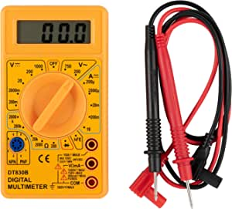
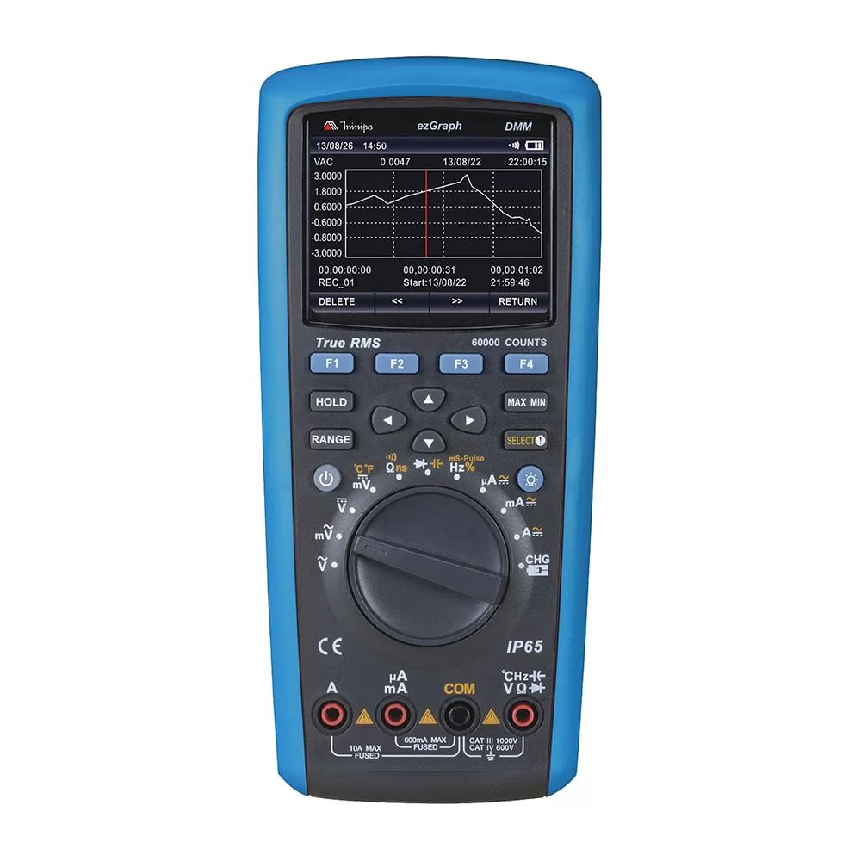
EXAMPLES OF MULTIMETERS
~R$26,00
~R$7800,00

Slide 16
HOW TO KNOW THE CIRCUIT AMPERAGE?
COPPER CABLES
METRIC STANDARD
ABNT NBR 5410
SECTION (mm²) | MAX. AMPERAGE
0.5 | 6 A
0.75 | 10 A
1 | 12 A
1.5 | 15.5 A
2.5 | 21 A
4 | 28 A
6 | 36 A
10 | 50 A
16 | 68 A
25 | 89 A
35 | 111 A
50 | 134 A
70 | 171 A
95 | 207 A
Single Phase / Biphasic
I = P / U
I = P / U x FP
Or
* Recommended
I = P / U x 1.15

Slide 17
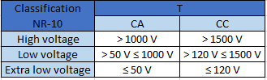
MAXIMUM VOLTAGE AND ELECTRICAL CURRENT THAT THE BODY CAN HANDLE
I = P / U

Slide 18
MAXIMUM VOLTAGE AND ELECTRICAL CURRENT THAT THE BODY CAN HANDLE
I = P / U = 100W / 110V = 0,90A = 900mA
1 mA = Body is able to feel
From 9 mA = Slightly painful process
From 9 to 20 mA = In addition to pain, the person loses part of muscle control and is unable to let go of the electrical conductor.
*** Above that, the problems become more serious, and can cause death.
75 mA = The electrical discharge begins to interfere with the heart, which also works with an electrical mechanism, causing a cardiac arrhythmia.

Slide 19
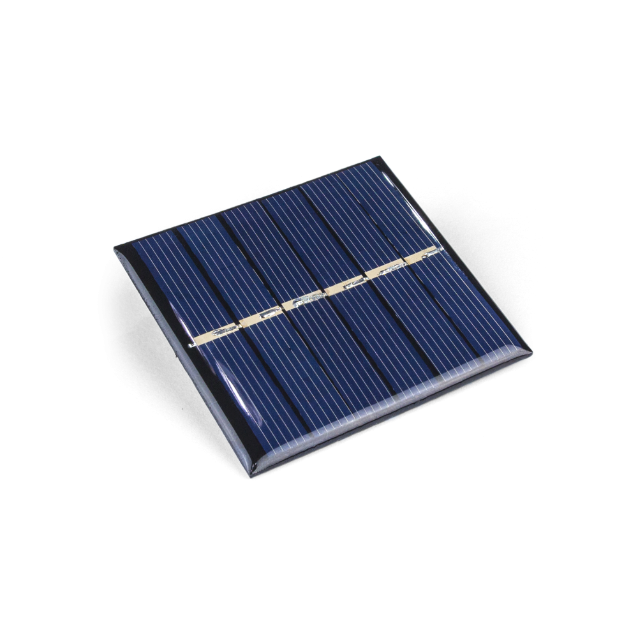
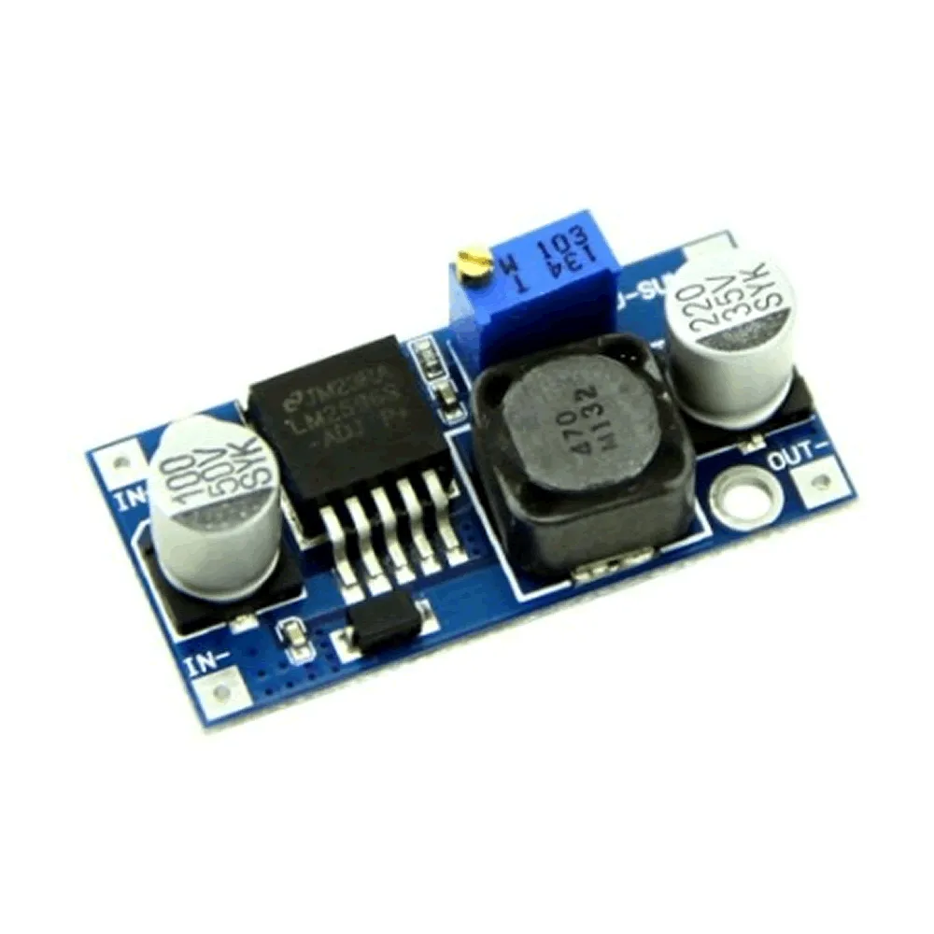
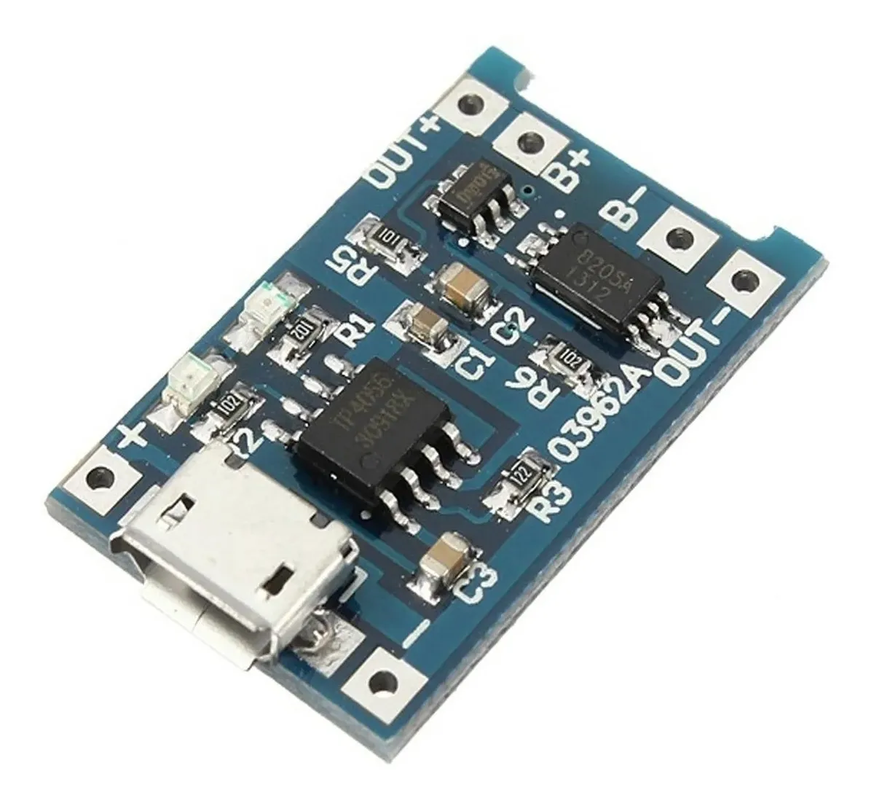
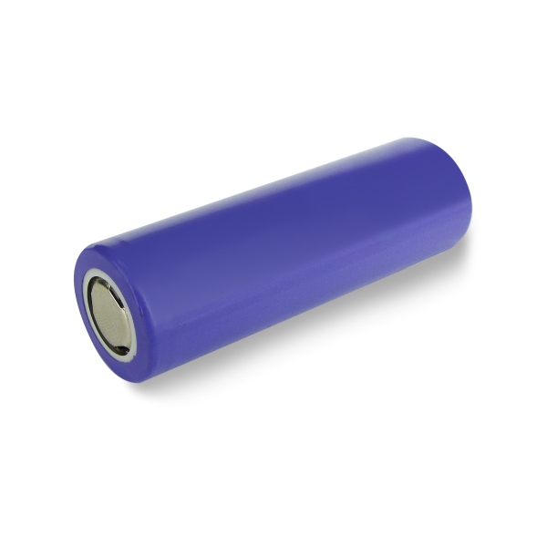
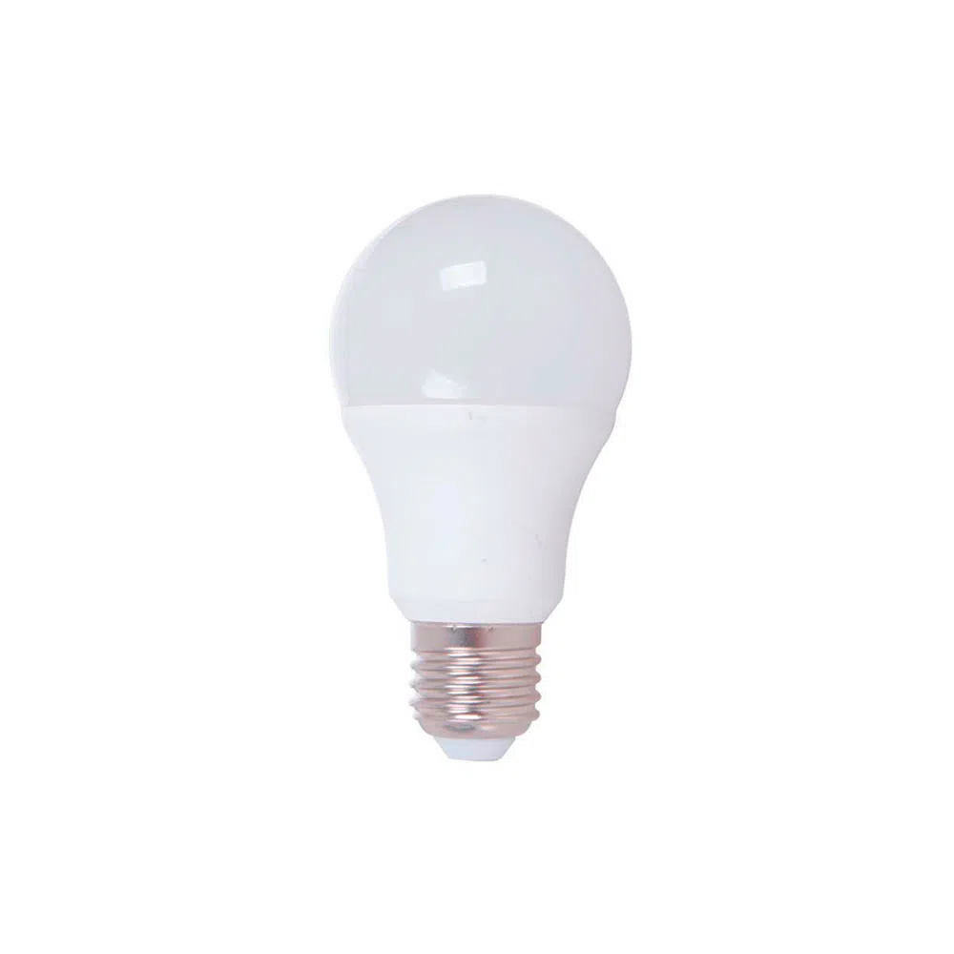
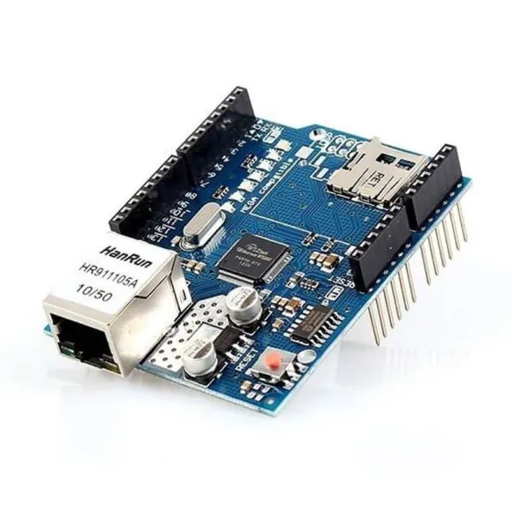
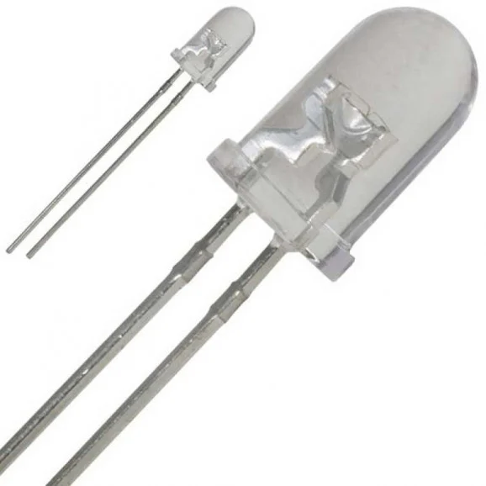
PROJECT
Lighting IoT project using photovoltaic energy.
Photovoltaic solar panel
Lithium battery charger – CN3065
Battery
Voltage regulator - Lm2596
Arduino Uno
Ethernet shild W5100
Led
Lamp

Slide 20
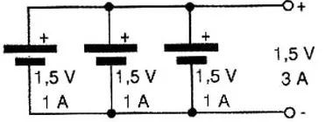
CONNECTING BATTERIES IN SERIES AND PARALLEL
PARALLEL
SERIES
Voltage = sum of each battery voltage
Electric current = keep the same

Slide 21


KEY PRECAUTIONS WHEN WORKING WITH MICROCONTROLLERS
.com
Always look for a qualified professional to work with electrical currents;
Always observe the supply voltage, working voltage, output voltage as well as the amperage of each component to be used;
Always check the technical specifications of microcontrollers
Draw or sketch the schematic
of the project before you go
shopping for parts.
Notes:
You can safely remove this slide. This slide was provided by PoweredTemplate.com – You can download more templates, shapes and diagrams for presentations from https://poweredtemplate.com

Slide 22


Slide 23
BIBLIOGRAPHY
MAXIMUM VOLTAGE AND ELECTRICAL CURRENT THAT THE BODY CAN HANDLE
https://super.abril.com.br/ciencia/que-voltagem-maxima-um-ser-humano-suporta/#:~:text=De%209%20a%2020%20miliamp%C3%A8res,provocando%20defici%C3%AAncia%20do%20sistema%20respirat%C3%B3rio
ARDUINO UNO R3 DATASHEET
https://docs.arduino.cc/hardware/uno-rev3
ESP32 DATASHEET
https://www.espressif.com/en/support/documents/technical-documents
DATASHEET RASPBERRY
https://datasheets.raspberrypi.com/

